Slide 1



Impact of covid-19 on higher education in india
Prepare & Presented by
Anmol Dedha

Slide 2
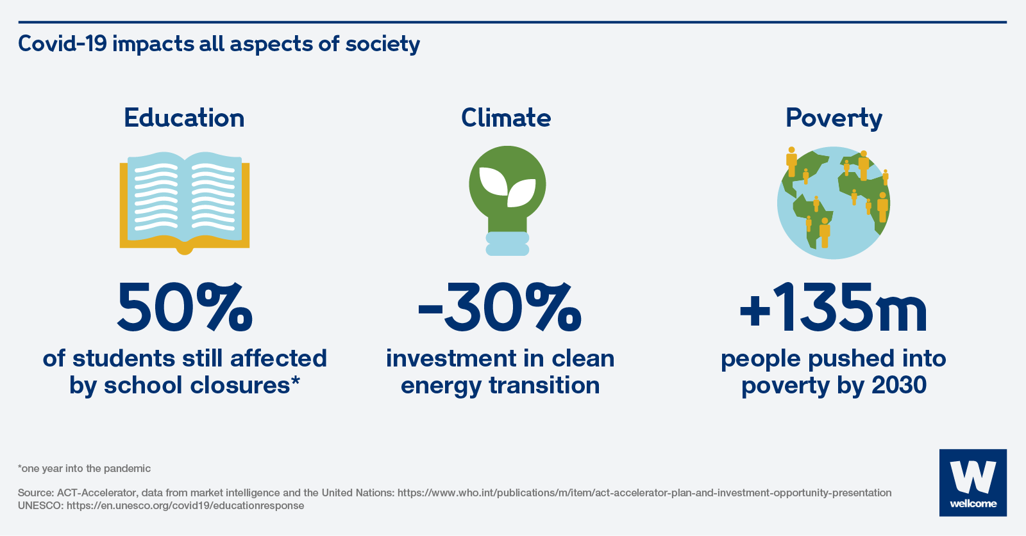
What, how, when of covid-19
On March 11, 2020 World Health Organisation (WHO) declared Covid-19 as a pandemic. Covid-19 has affected more than 4.5 million peoples worldwide (WHO).
In India, the first affected case of Covid-19 was detected on 30 January 2020 in the state of Kerala and the affected had a travel history from Wuhan, China.
From school closures to devastated industries and millions of jobs lost – the social and economic costs of the pandemic are many and varied.
Covid-19 is threatening to widen inequalities everywhere, undermine progress on global poverty and clean energy, and more.
The COVID-19 pandemic has led to a dramatic loss of human life worldwide and presents an unprecedented challenge to public health, food systems and the world of work.

Slide 3

Education system took a shift and become online
The Covid-19 pandemic is not only a global health problem but also has severe impacts on human and social life, including employment, education, agriculture etc.

Slide 4

education system battling with covid-19
POSITIVE V/S NEGATIVE IMPACTS

Slide 5


Positive impact Using online mode
Preparing for future requirements.
1
Flexibility and efficiency.
2
Accessibility of time and place .
3
Recording and revisiting
5
Worldwide reach.
4

Slide 6

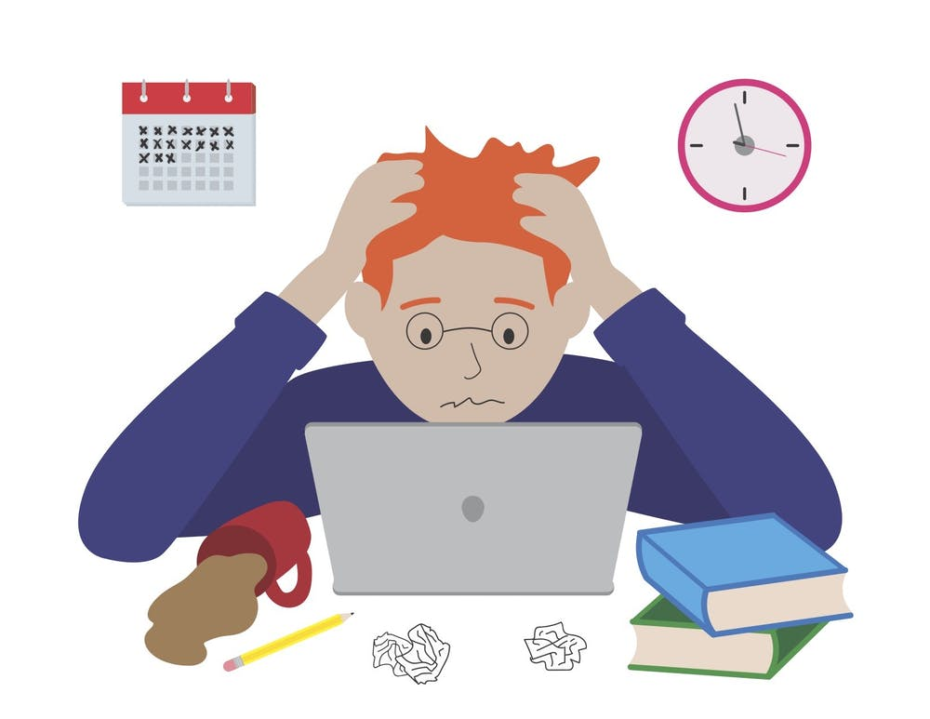
Negative impact Using online mode
Technology issues.
1
Digital divide.
2
Employment opportunities .
3
Peer group learning.
4
Impact on Psychical and Mental health
5

Slide 7
Financial Impact Of Covid-19 On Education
Negative
Some traditional educational institutions got shut down because they became loss making businesses
Many teachers lost their employment
Positive
Adoption of digital as the mainstream platform, Helped online education platforms like Unacademy, Byjus etc
Enhancement in use of IT equipment for Online video conferencing companies e.g Zoom, MS Team

Slide 8
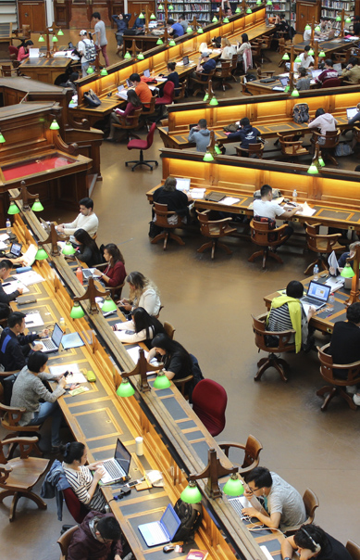

Recommendations
Educational institutions
Government and responsible authorities
Students

Slide 9

Recommendations for government
1. Speeding up the vaccination
4.Mass surveillance tools
5.Mobilize all the sectors and communities
2. Rules and Regulations
3. Awareness

Slide 10

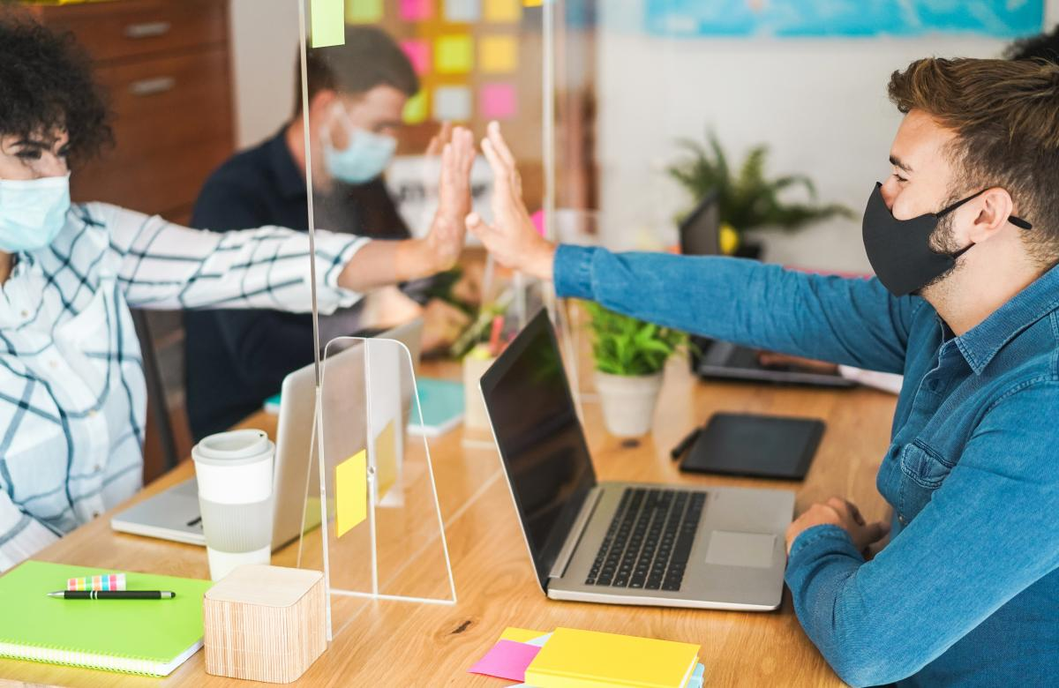
Recommendations for educational institutions
1. Supporting vulnerable groups
2. Guidance and counselling
3. Encouraging for vaccination
4.Address mental/physical health
5.Creating a campus bubble

Slide 11

Recommendations for Students
1. Maintaining connections
5.Stick with a good time table
3. Give yourself a break from social media
4. Do yoga/meditation/exercises
2. Taking care of your body and mind

